Slide 1
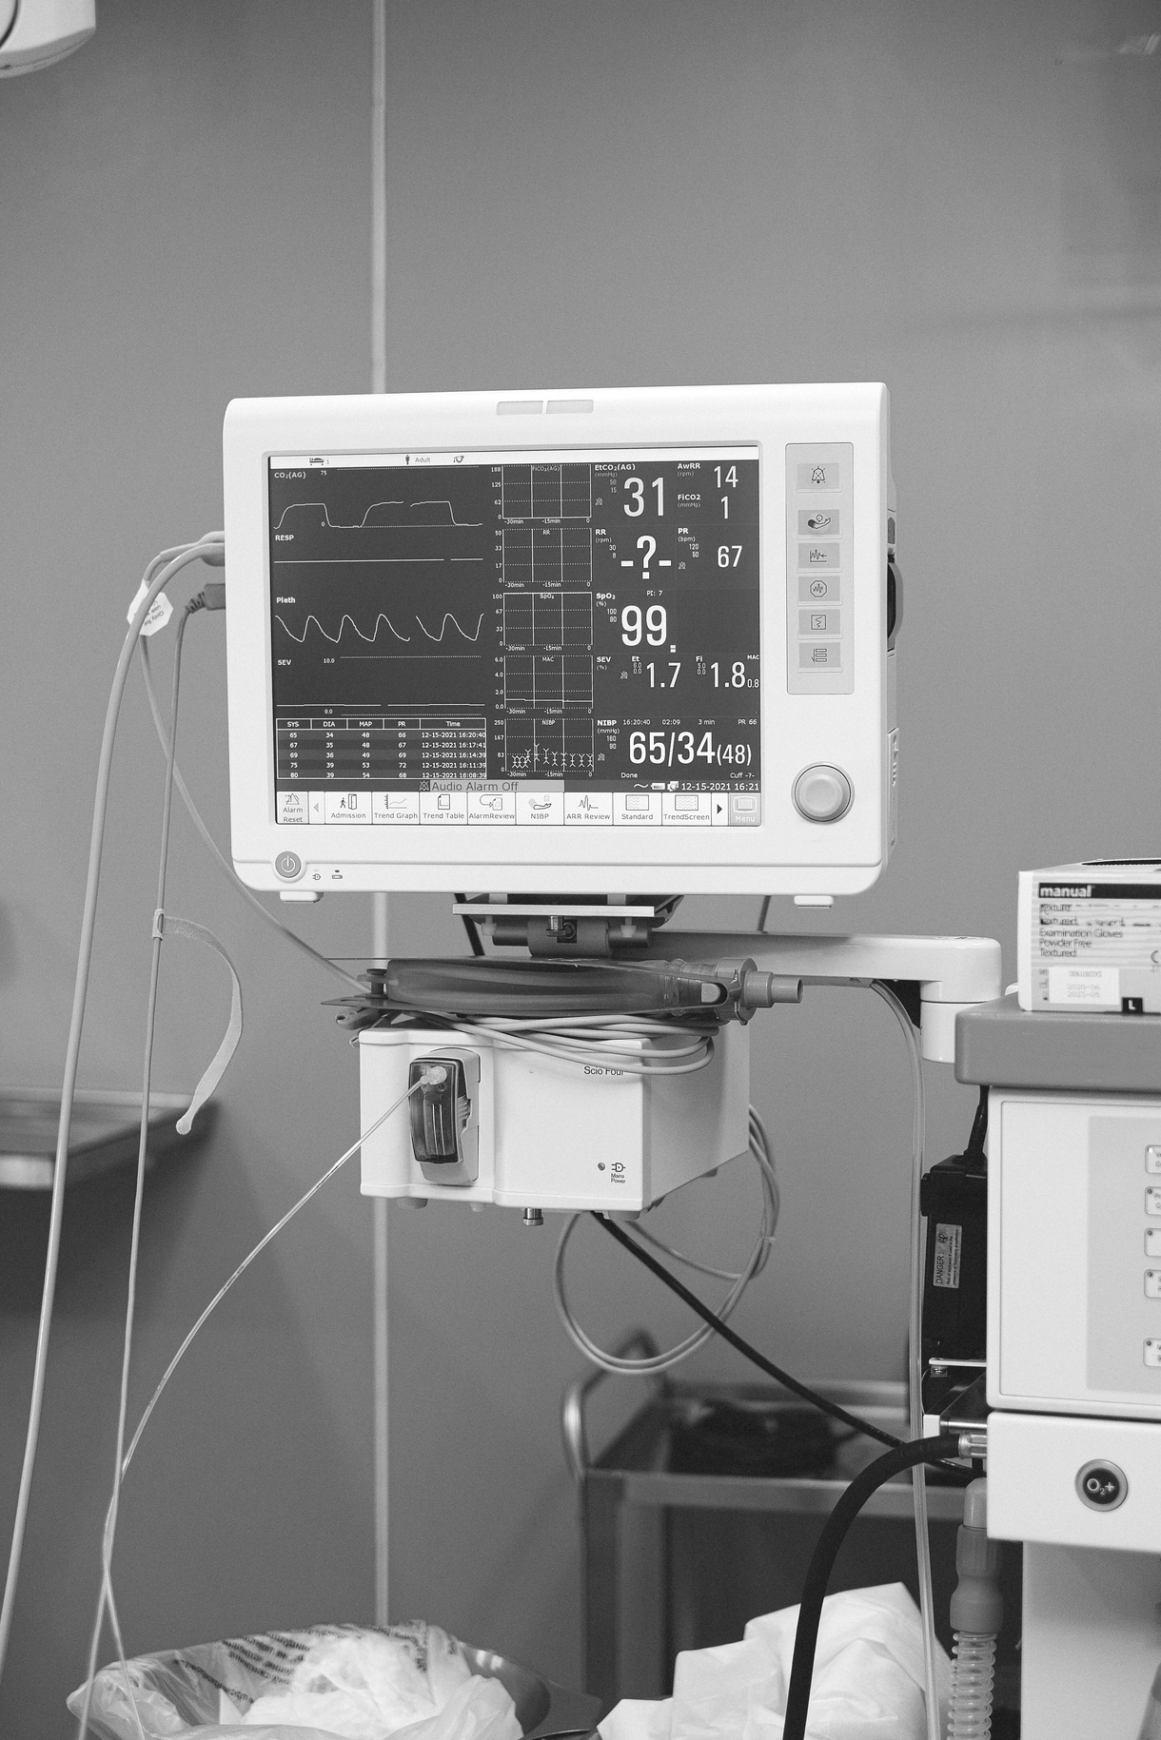



EUROPEAN UNIVERSITY OF LEFKE
Department of Software Engineering
HOSPITAL MANAGEMENT SYSTEM
Graduation Project II
Ali Can Doğan - 180343
Supervisor: Assoc. Prof. Dr. Ezgi Deniz Ülker

Slide 2


OUTLINE:
Introduction
Project Description
Importance of Project
Goals and Objectives
Challenges and Difficulties
Target Group
Approach and Methodology
Limitations
Future Directions and Recommendations
Conclusion

Slide 3
Introduction:
Technology has become an integral part of our lives, including the field of health, where it plays a crucial role. Integrating commonly used technology into healthcare processes offers convenience and efficiency.
The project focuses on providing fast and simple appointment and schedule management to its target users. It utilizes PHP codes in the background and employs database operations to store user data. Through HTML and Bootstrap, the system displays these background operations to users via SQL queries.
The significance of the project lies in the transition from traditional appointment and scheduling methods, which harm the environment, to immediate digital alternatives accessible through phones or computers.

Slide 4
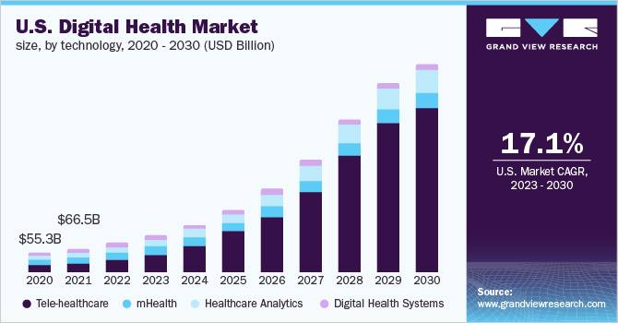
Technology's role in the global health sector is growing rapidly. The table provides current and projected digital health market rates for the U.S..

Slide 5

PROJECT DESCRIPTION:
Introducing the Doctor Appointment Booking System, a solution designed to streamline and optimize patient-doctor appointments in a hospital setting. Our system empowers patients to schedule appointments with doctors from specific departments, ensuring availability within their preferred time frame, tailored to their condition. Our ultimate objective is to establish a seamless, dependable, and user-friendly booking system.

Slide 6

BENEFITS OF PROJECT

Slide 7





No More Paper
Data-Base
Better Admin
Uniform standards help get rid of paper records
Database management protects and organizes all user data
Provides management of users and system
Standardizing
Record Keeping
The software helps in standardizing health management
Maintenance of proper records

Slide 8
GOALS & OBJECTIVES
Primary objective is to develop a user-friendly, fast, and reliable hospital management system that caters to the needs of our users. We aim to provide a seamless appointment booking experience for users, enable doctors and secretaries to efficiently manage schedules, and grant administrators full control over the system.

Slide 9
CHALLENGES & DIFFICULTIES
During the project, I encountered challenges related to establishing front-end and back-end connections. Additionally, I faced difficulties in designing interfaces and encountered obstacles while attempting to send emails via localhost.
To overcome these challenges, I adopted a systematic approach by breaking down the code into smaller parts. I diligently searched for the source of errors and utilized various online resources to find solutions.
It is important to note that these challenges provided valuable insights and knowledge in the areas of front-end and back-end development.

Slide 10

TARGET GROUP:
The target audience for my project encompasses individuals in need of hospital appointments and hospitals seeking to transition from traditional data keeping methods to virtual systems.
User satisfaction stands as a paramount feature to consider during project development. I empathetically placed myself in the users' shoes, envisioning how they could comfortably utilize the system's functions. Consequently, the project goals successfully fulfill the users' needs as promised.

Slide 11
LIMITATIONS:
TIME CONSTRAINT: The project encountered time constraints that could affect the scope of implemented features and functions.
RESOURCE CONSTRAINTS: Limitations in terms of budget, human resources or technological infrastructure affected the scope and scale of the project.
COMPATIBILITY ISSUES: These compatibility limitations have affected the user experience and accessibility of the system.
SECURITY CONSIDERATIONS: Implementing robust security measures to protect sensitive user information and prevent unauthorized access.
SCALABILITY LIMITATIONS: Limitation in terms of scalability, i.e. increased number of users and ability to manage data, depending on the design and infrastructure of the project.

Slide 12
FUTURE DIRECTIONS & RECOMMENDATIONS:
A live support feature for real-time assistance,
A messaging feature to enable direct communication with doctors,
Collecting additional user information to enhance and facilitate communication with doctors,
Implementing email verification for improved security,
Displaying more comprehensive statistics for better insights,
Expanding the schedule management system to provide more detailed functionality.

Slide 13
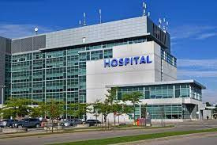
Conclusion
A user-friendly, understandable, and easy-to-use hospital management system has been created. The system can be monitored even by people who not have detailed knowledge about the technology.
There are also many benefits of the system; It provides to transition between traditional data collection methods to modern database management systems, more efficient and faster doctor-patient communication, patient data management, and access to data, Also it prevents time wasting with appointment reminders.

Slide 14
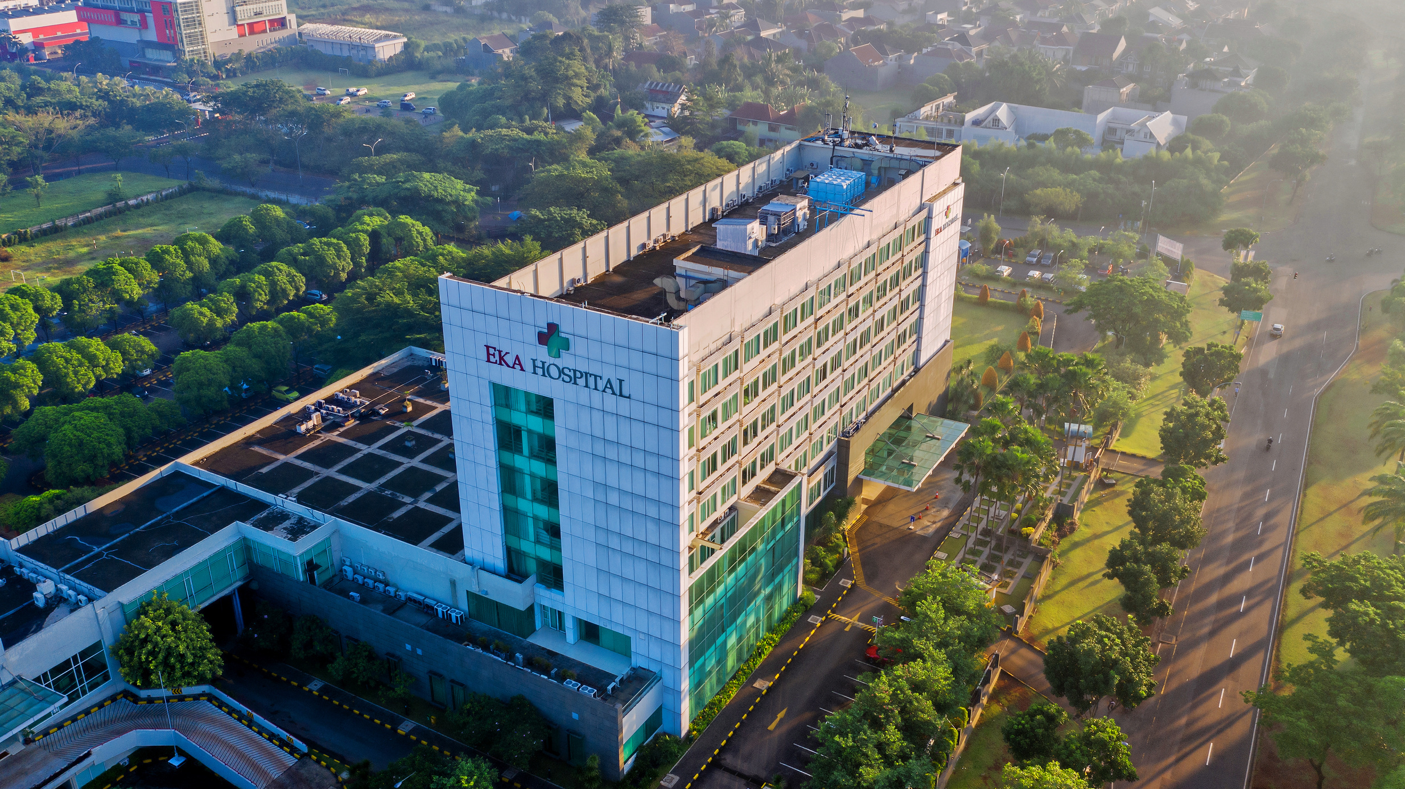
Thank You
For Your Time!

